Slide 1
TicketTitan
Movie Ticket Booking System
Presented to you by Ticket Masters

Slide 2

Streamlining the Ticket Booking Process
Reduce wait times
Improve accuracy
Real-time data analytics

Slide 3
Moukthika
Pruthvi
Samarth
Meet the Team:
Zahra

Slide 4
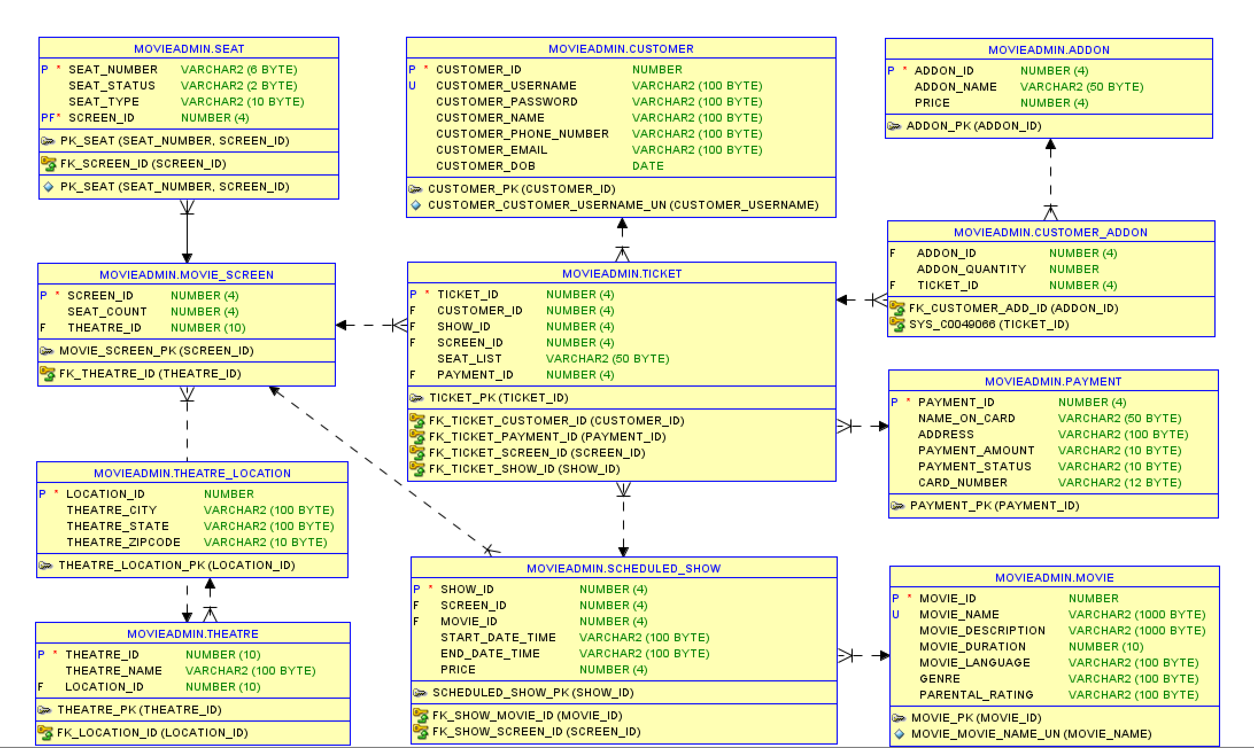
ER Diagram

Slide 5
Zahra Marhoon
Background:
BSc in Mechanical Engineering
MS in Civil Engineering, Concentration in Data and Systems
Professional Experience as Quality Engineer
Project contributions:
Drafted business rules
Created Data Flow Diagram
Generated Entity Relationship Diagram (ERD)
Produced Oracle SQL reports and analytical charts
Formatting of group reports and presentations

Slide 6
Samarth Chetan
Background:
BSc in Computer Science
MS in Data Analytics Engineering
Professional Experience as Data Scientist
Project contributions:
Defined scope and goals of project
Regular communication and follow-up with TA’s
Outlined database logic
Provided user access for database
Generated analytical reports

Slide 7
Pruthvi Niranjan
Background:
BTech in Computer Science
MS in Computer Software Engineering
Professional Experience in Testing and Debugging
Project contributions:
Managed access control
Entered data into database
Handled debugging of system
Created users and roles
Movie admin procedures

Slide 8
Moukthika Manapati
Background:
BSc in Computer Science
MS in Information Systems
Professional Experience as Software Engineer
Project contributions:
Created data tables
Created database views
Created packages
Worked on user functionality
User signup

Slide 9

Demo
Let us show you how our system works!

Slide 10
Thank you for tuning in!
Please feel free to ask questions

